Slide 1
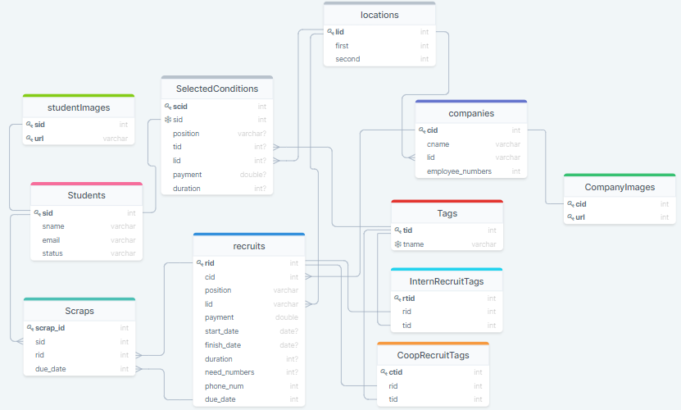

Slide 2
학생 테이블
sid(학생번호), sname(이름), email, status(등록 상태)
CREATE TABLE Students (
sid int NOT NULL PRIMARY KEY,
password varchar NOT NULL,
sname varchar NOT NULL,
email varchar NOT NULL,
status varchar NOT NULL,
);
학생 이미지 테이블
Sid(학생번호, FK), url
CREATE TABLE StudentImages {
sid int NOT NULL FOREIGN KEY REFERENCES Students(sid),
url varchar NOT NULL
PRIMARY KEY (sid, url)
);
위치 테이블
Lid(위치번호), first(시/도), second(구/시)
CREATE TABLE Locations {
lid int NOT NULL PRIMARY KEY,
first varchar NOT NULL,
second varchar NOT NULL
);
기업 테이블
cid(기업번호), cname(기업명), lid(위치id), employee_numbers(직원수)
CREATE TABLE Companies (
cid int NOT NULL PRIMARY KEY,
cname varchar NOT NULL,
location varchar NOT NULL,
Employee_numbers NOT NULL,
);
기업 이미지 테이블
cid(기업번호, FK), url
CREATE TABLE CompanyImages {
cid int NOT NULL FOREIGN KEY,
url varchar NOT NULL
PRIMARY KEY (cid, url)
);

Slide 3
태그 테이블
Tid(태그번호), tname
CREATE TABLE Tags (
tid int NOT NULL PRIMARY KEY,
tname1 varchar NOT NULL,
);
모집 테이블
Rid(모집번호), cid(기업번호), position, lid(위치번호), payment, start_date, finish_date, duration, need_numbers, phone_num, due_date
CREATE TABLE Recruits (
rid int NOT NULL PRIMARY KEY,
cid int NOT NULL FOREIGN KEY REFERENCES Companies(cid),
position varchar NOT NULL,
location varchar NOT NULL,
payment double NOT NULL,
start_date date,
finish_date date,
duration int,
need_numbers int,
phone_num varchar,
due_date date NOT NULL,
);
인턴십 모집공고 태그 테이블
Rtid, rid, tid
CREATE TABLE InternRecruitTags (
rtid int NOT NULL PRIMARY KEY,
rid int NOT NULL FOREIGN KEY REFERENCES Recruits(rid),
tid int NOT NULL FOREIGN KEY REFERENCES Tags(tid)
);

Slide 4
산학 모집공고 태그 테이블
Ctid, rid, tid
CREATE TABLE CoopRecruitTags (
ctid int NOT NULL PRIMARY KEY,
rid int NOT NULL FOREIGN KEY REFERENCES Recruits(rid),
tid int NOT NULL FOREIGN KEY REFERENCES Tags(tid)
);
스크랩 테이블
Scrap_id(스크랩번호), sid, rid, due_date
CREATE TABLE Scraps (
scrap_id int NOT NULL PRIMARY KEY,
sid int NOT NULL FOREIGN KEY,
rid int NOT NULL FOREIGN KEY,
due_date date NOT NULL FOREIGN KEY
)
조건 저장 테이블
Scid(조건저장id), sid, postion, tid, lid, payment, duration
CREATE TABLE SelectedConditions (
scid int NOT NULL PRIMARY KEY,
sid int NOT NULL FOREIGN KEY REFERENCES Students(sid),
position varchar,
tid int,
lid int,
payment double,
duration int
);

